Slide 1





AnalytixCloud
Dimension Modelling
www.analytixcloud.com
www.youtube.com/@AnalytixCloud
www.t.me/azuredatafactory_azuredatabicks
www.linkedin.com/company/analytixcloud
© 2023 AnalytixCloud Pvt. Ltd. All rights Reserved.

Slide 2
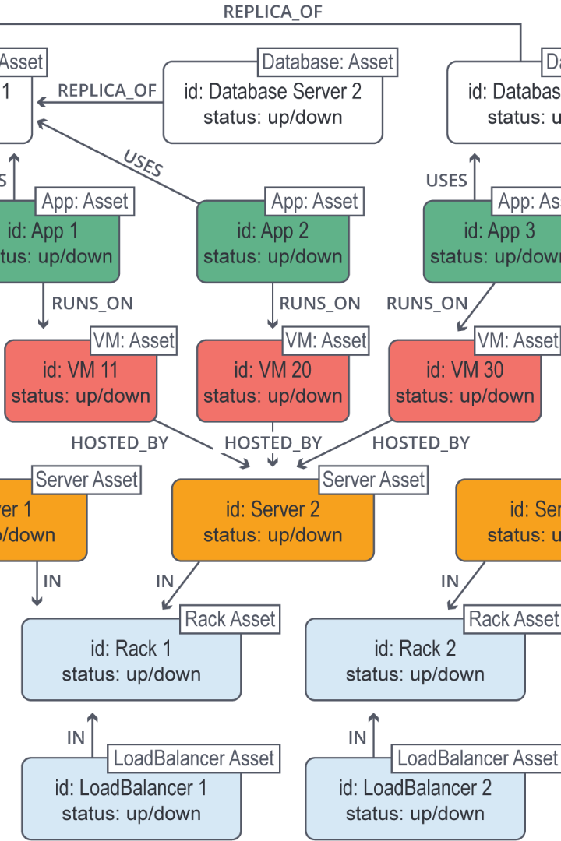

Data Modelling
Data modelling is a crucial process that helps organizations analyze and organize their data to make informed decisions. Let's dive into the world of data modelling and its importance.
© 2023 AnalytixCloud Pvt. Ltd. All rights Reserved.

Slide 3

Types of Data Modeling
1
Hierarchical data models
represent one-to-many relationships in a treelike format. In this type of model, each record has a
single root or parent which maps to one or more child tables.
2
Relational data models
Relational databases frequently employ structured query language (SQL) for data management. These databases work well for maintaining data integrity and minimizing redundancy. They’re often used in point-of-sale systems, as well as for other types of transaction processing.
3
Entity-relationship (ER) data models
use formal diagrams to represent the relationships between entities in a database.
4
Object Oriented data models
The “objects” involved are abstractions of real-world entities. Objects are grouped in class hierarchies, and have associated features.
5
Dimensional data models
developed by Ralph Kimball, and they were designed to optimize data retrieval speeds for analytic purposes in a data warehouse. While relational and ER models emphasize efficient storage, dimensional models increase redundancy in order to make it easier to locate information for reporting and retrieval.
© 2023 AnalytixCloud Pvt. Ltd. All rights Reserved.

Slide 4
Process of Data Modelling
1
Requirements Gathering
Gather business requirements and identify the data entities and their relationships.
2
Conceptual Modelling
Create an abstract representation of the data entities and their relationships.
3
Logical Modelling
Translate the conceptual model into a more detailed and structured representation.
4
Physical Modelling
Design how the logical model will be implemented using a specific database system.
© 2023 AnalytixCloud Pvt. Ltd. All rights Reserved.

Slide 5

Importance of Data Modelling in Database Design
1
Organizing Data
Data modelling helps in defining the structure of the database, making it easier to organize and manage.
2
Reducing Redundancy
By eliminating data redundancy, data modelling enhances efficiency and reduces storage requirements.
3
Improving Data Quality
Data modelling ensures accurate and consistent data by enforcing constraints and relationships.
© 2023 AnalytixCloud Pvt. Ltd. All rights Reserved.

Slide 6

Fact Tables and Dimension Tables
Fact Tables
Dimension Tables
Star Schema and Snowflake Schema
Fact tables contain the measurements, metrics, or facts of a business process.
Dimension tables provide descriptive attributes related to the facts in the fact tables.
Star schema and snowflake schema are common data warehousing models used to organize fact and dimension tables.
© 2023 AnalytixCloud Pvt. Ltd. All rights Reserved.

Slide 7
Dimension Table Design
1
Primary and Foreign Keys
Primary keys uniquely identify records in dimension tables, while foreign keys establish relationships with fact tables.
2
Attributes and Hierarchies
Attributes provide additional information about dimensions, while hierarchies define the relationships between attributes.
3
Slowly Changing Dimensions (SCDs)
SCDs handle changes to dimension data over time, preserving historical and current values.
© 2023 AnalytixCloud Pvt. Ltd. All rights Reserved.

Slide 8
Fact Table Design
1
Measures
Quantifiable data elements that provide insights or support calculations.
2
Granularity
The level of detail at which data is stored and analyzed within the fact table.
3
Chose Dimension
once the grain of the fact table is stated clearly, it is time to determine dimensions for the fact table.
© 2023 AnalytixCloud Pvt. Ltd. All rights Reserved.

Slide 9
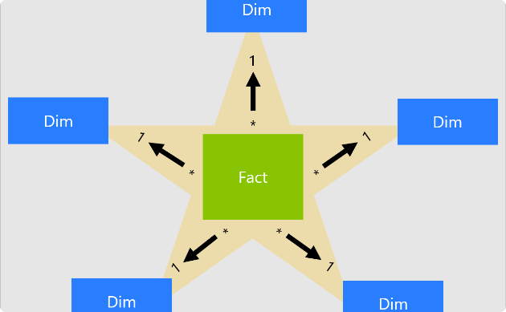
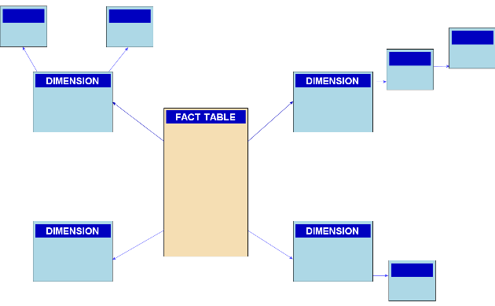
Star Schema and Snowflake Schema
Star Schema
Snowflake Schema
Central fact table surrounded by dimension tables, forming a star-like structure.
Extended version of the star schema with normalized dimension tables.
© 2023 AnalytixCloud Pvt. Ltd. All rights Reserved.

Slide 10

Use Case
© 2023 AnalytixCloud Pvt. Ltd. All rights Reserved.

Slide 11
Common Challenges in Data Modelling
Data Inconsistency
Complex Relationships
Scalability Issues
Inaccurate, incomplete, or duplicate data can lead to inconsistent analysis and decision making.
Data models sometimes involve complex relationships that require careful consideration and documentation.
As data volumes grow, data modelling techniques need to accommodate the increasing scale effectively.
© 2023 AnalytixCloud Pvt. Ltd. All rights Reserved.

Slide 12

Best Practices in Data Modelling
Common Challenges in Data Modelling
1
Standardization of Naming Conventions
2
Documentation and Maintenance
3
Collaboration between Business and IT Teams
Data Inconsistency
Complex Relationships
Scalability Issues
Inaccurate, incomplete, or duplicate data can lead to inconsistent analysis and decision making.
Data models sometimes involve complex relationships that require careful consideration and documentation.
As data volumes grow, data modelling techniques need to accommodate the increasing scale effectively.
Thorough documentation and regular updates ensure the longevity and reliability of data models.
Consistent naming conventions improve understanding and maintainability of data models.
Cross-functional collaboration ensures alignment between business requirements and technical implementation.
© 2023 AnalytixCloud Pvt. Ltd. All rights Reserved.

Slide 13
Thank You
© 2023 AnalytixCloud Pvt. Ltd. All rights Reserved.

